Slide 1



Re-Parcellation of The Human Brain Using the Harvard Oxford Atlas
Performed on the The Midnight Scan Club (MSC) dataset from OpenNeuro (ds000224)
Prepared by: Nagham Mohamed - 7200337
Supervised by: Prof. Storace and Prof. Lodi

Slide 2




TABLE OF CONTENTS
01
Dataset Description
02
Slice-Time & Motion Correction
03
Skull-Stripping of T1 Images
04
Coregistration of T1 to EPI
05
Skull-Stripping of Functional EPI
06
Projecting the HO Atlas on the warped EPI Image
07
Time-Series Extraction and ROI Functional Connectivity
08
Visualization of the overlaid Atlas on the brain

Slide 3
01 - Dataset Description
1.1 Dataset Overview
Dataset name: Midnight Scanning Club (MSC)
OpenNeuro ID: ds000224, version 00002
Purpose: To provide high-quality, multi-session resting-state and task fMRI data for studying individual differences in brain organization.
1.2 Participants
Number of subjects: 10 healthy adults (5 males, 5 females)
Age range: 24–34 years
Right-handed, with normal or corrected-to-normal vision.
Each subject participated in 10 separate scanning sessions, allowing within-subject reproducibility studies.
1.3 Image Aquisition
Each subject’s dataset includes:
Structural MRI (T1-weighted): High-resolution anatomical images for alignment and normalization.
Functional MRI (fMRI):
Resting-state scans: Eyes open, fixating on a cross.
Task scans: Motor, memoryfaces, memorywords, memoryscenes, glasslexical.

Slide 4
02 - Slice-Time and Motion Correction
Goal of this Stage
A- Objective:
Remove timing offsets between slices and head-motion artifacts before modeling.
B- Steps implemented (SPM):
Slice-Timing Correction (STC) → temporal interpolation to a common reference time.
Realignment (6-DOF rigid-body) → estimate motion; reslice images.
C- What is SPM?
SPM (Statistical Parametric Mapping) is a MATLAB toolbox for preprocessing and statistical analysis of brain imaging (fMRI, PET, MRI). It provides standardized pipelines (batch/scripting) for slice-timing correction, realignment, coregistration, normalization, smoothing, and model estimation.
D- Why it matters?
Slice offsets distort the BOLD (Blood-Oxygen-Level-Dependent) phase; motion induces spurious correlations and false activations.

Slide 5
02 - Slice-Time and Motion Correction
STC - Concept Behind the Scene
A- Problem:
EPI acquires slices sequentially, so each volume’s slices are sampled at different times within the same TR.
TR (Repetition Time): the time between successive excitations of the same slice (or volume). In fMRI, it’s the sampling interval of the BOLD time series.
B- Significance:
Temporal misalignment of voxel time series and task regressors. This can reduce detection power, especially in event-related designs and for longer TRs.
C- What STC does:
STC interpolates each voxel’s time series to a common reference time (a “reference slice”; often the middle slice to minimize average shift). Only the reference slice is not interpolated; all others are shifted in time toward it.

Slide 6
02 - Slice-Time and Motion Correction
STC - SPM Implementation
A- Inputs:
Repetition Time (TR) and SliceTiming (one time per slice).
Compute TA = TR − TR/nslices (time from first to last slice within a volume).
B- Derive SPM Batch Parameters:
nslices = length(SliceTiming)
slice_order = sort(SliceTiming) → converts true acquisition times to an ascending order list for SPM.
refslice = round(nslices/2) → use the middle slice as reference to minimize average temporal shift.
C- What STC does:
First step is to pull TR and exact per-slice times from BIDS, compute TA, recover the true acquisition order, and align all slices to the middle-slice time using SPM’s sinc-based interpolation. Outputs are assigned a prefix (a*.nii) for the next step.

Slide 7
02 - Slice-Time and Motion Correction
Motion Correction - Concept Behind the Scene
A- What is modeled?
Treat the head as a rigid body: every fMRI volume is related to a reference by 6 parameters → 3 translations (x,y,z) and 3 rotations (pitch, roll, yaw).
Realignment estimates these per-volume transforms so all frames describe the brain in a common coordinate system
B- How it is done:
SPM minimizes sum of squared differences between each volume and the reference, using iterative optimization. Mild smoothing (FWHM) and a sampling step (sep) make the cost function well-behaved; after parameter estimation, volumes are resliced (interpolated) onto the reference grid.
C- Choice of the reference:
First image: preserves original intensity framing; avoids circularity from averaging across motion.
Mean image: sharper target and better SNR, but built from already-misaligned frames.
In this pipeline, the choice is the first image.

Slide 8
02 - Slice-Time and Motion Correction
Motion Correction - SPM Implementation
A- Overview:
we feed all a*.nii volumes to SPM Realign (Estimate & Reslice), registering each volume with a 6-DOF rigid transform to the first image (rtm=0).
SPM then writes the resliced series ra*.nii and a mean EPI meana*.nii, and saves rp_*.txt (6 motion parameters/TR) for nuisance regression and QC.
B- SPM Batch Parameters:
sep = 3 mm (sampling separation)
Grid step for sampling the cost function during estimation. Smaller = finer search (better convergence on subtle motion) but slower. Typical: 2–4 mm; we use 3 mm as an accuracy–speed compromise.
fwhm = 6 mm (estimation smoothing)
Temporary Gaussian smoothing during parameter estimation only to stabilize the SSD cost function under noise/edges. Larger values ease optimization but can blur features; 6 mm is a well-used default.

Slide 9
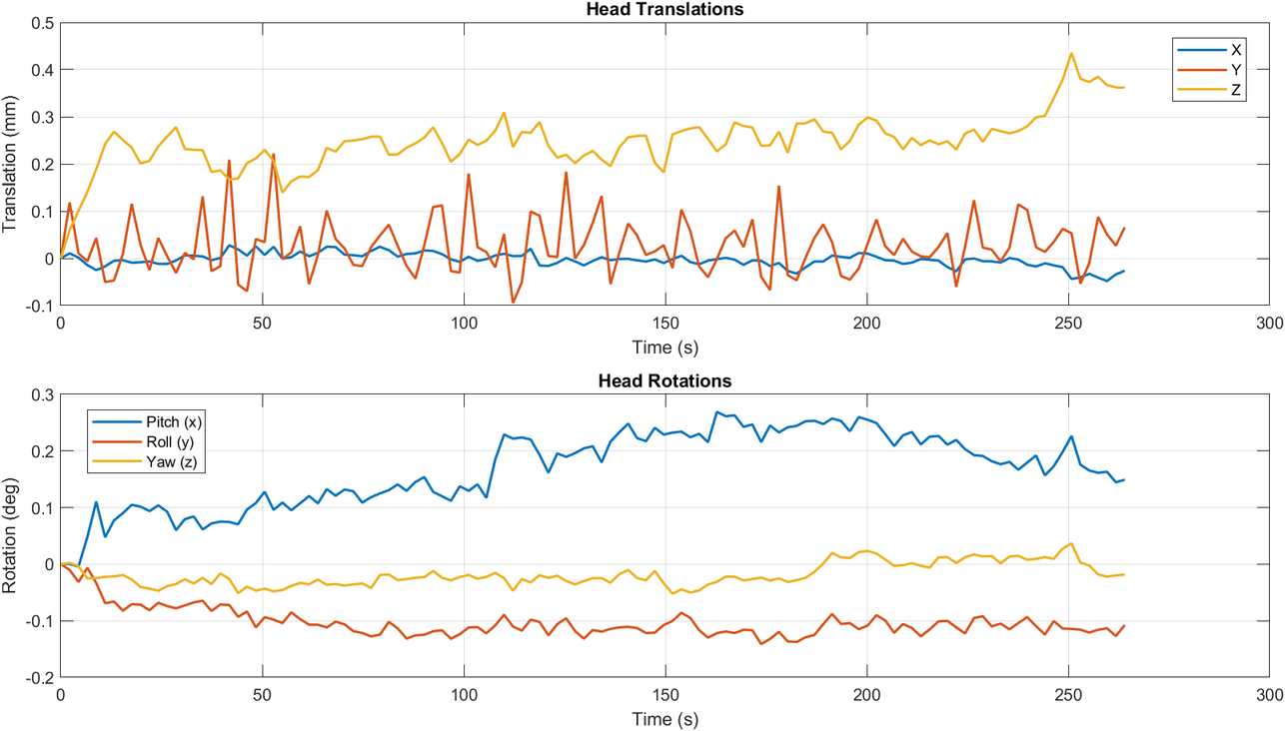
02 - Slice-Time and Motion Correction
Motion Correction - SPM Implementation
interp (interpolation order)
Estimation: eoptions.interp = 2 (B-spline, smooth derivatives for the optimizer).
Final reslice: roptions.interp = 4 (higher-order B-spline → better spatial fidelity than trilinear).
C- Visualization of Motion Parameters:
There’s a gradual drift in Z translation and Pitch rotation over time, which may indicate slow head movement
The most stable parameter is X translation, while Z translation and Pitch rotation show the greatest drift.

Slide 10
03 - Skull-Stripping of T1 Images
Goal of this Stage
A- Rationale:
Remove non-brain tissues (scalp, skull, dura) from the anatomical T1 so downstream coregistration and normalization and atlas projection are more accurate and faster.
B- Approach:
Use SPM Unified Segmentation on the T1 to estimate GM/WM/CSF probability maps,.
Derive an intracranial mask (ICV), and apply it to a bias-corrected mean T1 (averaged across two runs).
Simple averaging improves SNR approximately with √N
C- What is Unified Segmentation?
Unified Segmentation jointly models bias-field, tissue classes (mixture of Gaussians), and priors (TPMs) within one generative framework.
mask = GM+WM+CSF. These three classes (Grey Matter, White Matter, Cerebrospinal Fluid) define intracranial contents; summing their posteriors approximates ICV and excludes skull/skin tissues. (SPM also defines 6 tissue priors including non-brain.)

Slide 11
03 - Skull-Stripping of T1 Images
SPM Implementation
A- Steps:
Run SPM Unified Segmentation on T1#1 and on the mean of T1#1+T1#2.
Build a brain mask as (GM+WM+CSF)>0.3
Apply it to the bias-corrected mean T1 to produce mean_T1_stripped.nii.
On reruns, the cached outputs are used to regenerate the Quality Check (QC) figures without rerunning the pipeline.
B- Outputs:
mean_T1.nii → anatomical target for coregistration.
mmean_T1.nii → bias-corrected mean T1.
brain_mask_meanT1.nii → intracranial mask (GM+WM+CSF).
mean_T1_stripped.nii → brain-only T1 for coregistration to EPI and for atlas work.

Slide 12
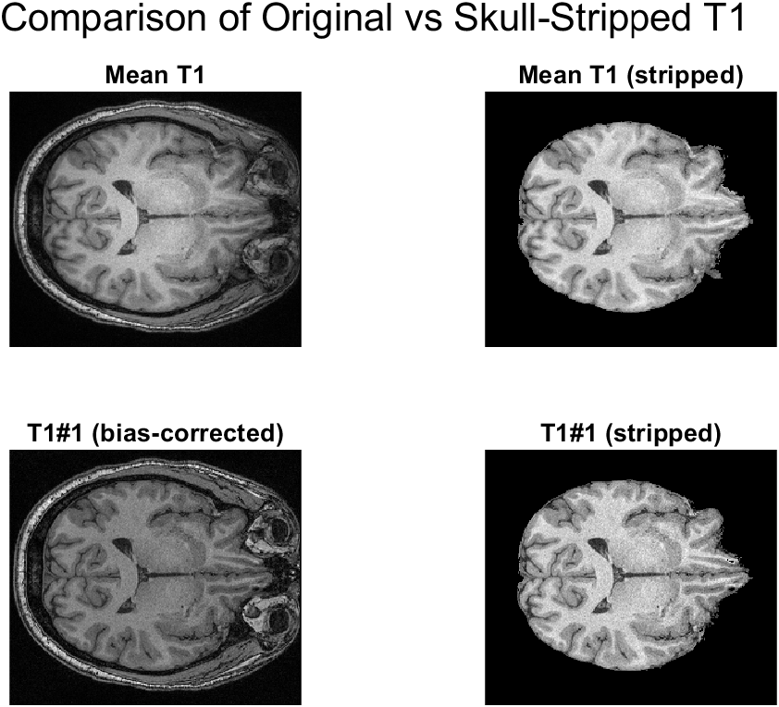
03 - Skull-Stripping of T1 Images
Visualization of the 2x2 QC Figure
The bias-corrected stripped image (bottom right) has sharper tissue boundaries and more uniform intensity, ideal for processing pipelines
The mean images suggest good alignment and averaging — no obvious blurring from motion.

Slide 13
04 - Coregistration of T1 to EPI
Goal of this Stage
A- Approach:
Put the mean EPI (BOLD, distorted & low-contrast) into the T1 (high-contrast, undistorted) anatomical frame using a rigid 6-DOF transform—without resampling yet.
Then apply the same header transform to the entire 4D EPI, so later steps reslice just once (one-interpolation principle).
B- Why NMI (Normalized Mutual Information)?
Problem:
EPI (BOLD) and T1 images come from different MRI contrasts:
T1 → bright white matter, dark CSF
EPI (BOLD) → the opposite: dark white matter, bright CSF
That means their intensity patterns don’t match — so similarity measures like Sum of Squared Differences (SSD) or Correlation fail, because they assume a linear intensity relationship.

Slide 14
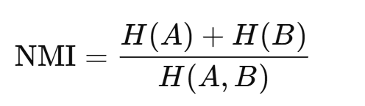
04 - Coregistration of T1 to EPI
Goal of this Stage
2. Solution:
Mutual Information (MI) measures how much knowing the intensity in one image reduces uncertainty about the other — it captures statistical dependence, not direct intensity matching.
Normalized MI (NMI) is a version that’s scale-invariant, so it works even if the images have different dynamic ranges or partial overlaps (like when fields of view differ).
NMI computes the joint histogram of intensities between the two images and finds the rigid transform that maximizes shared information.
Formally,
Maximizing NMI ⇒ best spatial alignment between modalities.
where H(A), H(B) are marginal entropies, and H(A,B) is joint entropy.

Slide 15
04 - Coregistration of T1 to EPI
SPM Implementation
A- Design
Reference (fixed): skull-stripped T1 → removes scalp/skull edges that can mislead the optimizer.
Source (moving): mean EPI → higher SNR & less noise than a single EPI frame.
Apply to “other”: the full 4D EPI → headers updated in-place; voxel data untouched (no blur yet).
B- SPM Batch Parameters:
sep = [4 2] : Multi-resolution sampling step, mm
tol = [0.02 0.02 0.02 0.001 0.001 0.001 0.01 0.01 0.01 0.001 0.001 0.001] : Small step-size thresholds for translations (mm) and rotations (rad) (first six entries)
Estimate-only; header update
No voxel interpolation now. SPM writes the 6-DOF transform into the headers of the source and “other” images to limit blur

Slide 16
05 - Skull-Stripping of Functional EPI
Goal of this Stage
A- Rationale:
Remove non-brain voxels from the mean EPI and the full 4D EPI (in EPI space) using a single static mask, so later modeling isn’t confounded by scalp/skull/air signals.
B- Approach and Implementation:
One mask for all timepoints: apply the same 3D mask to every TR which avoids time-varying censoring that can introduce artifactual dynamics and connectivity biases.
Binary labels stay binary: resample masks with nearest-neighbor only (no partial voluming). This prevents fuzzy edges and unintended erosion/dilation of brain borders.

Slide 17
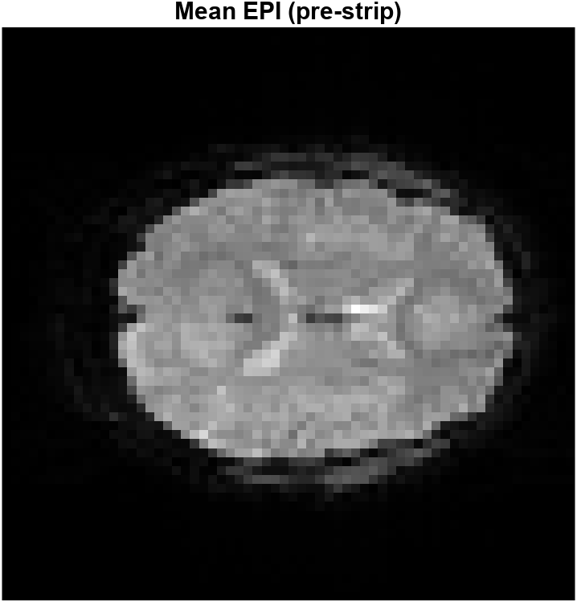
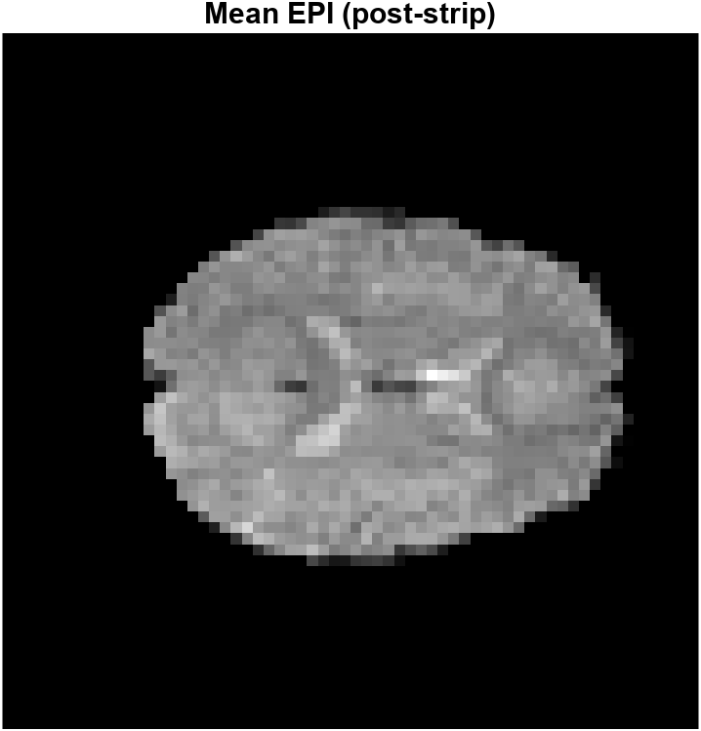
05 - Skull-Stripping of Functional EPI
Visualization of the QC Figures:

Slide 18
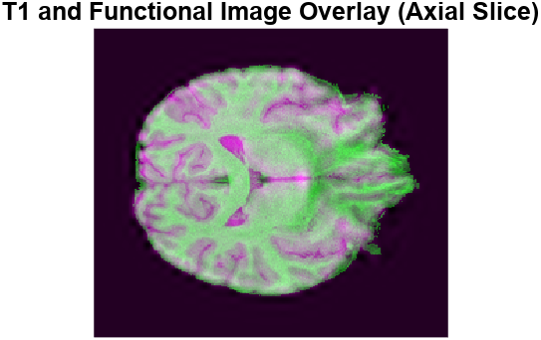
05 - Skull-Stripping of Functional EPI
Visualization of the QC Figures:

Slide 19
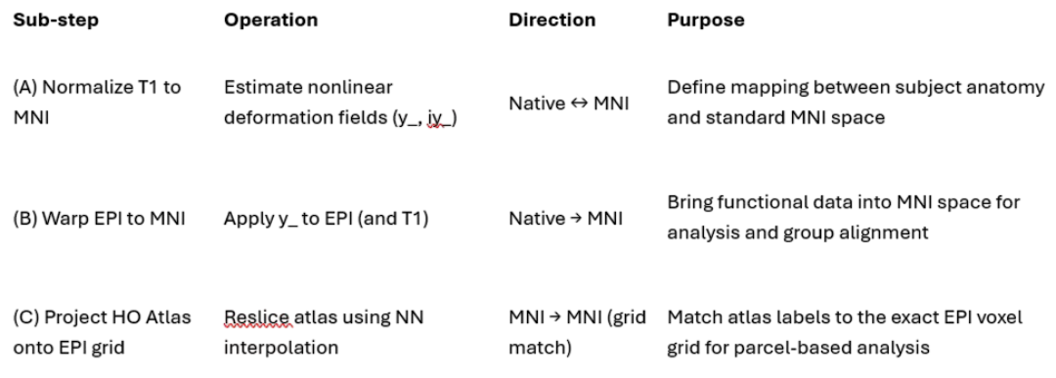
06 - Projecting the HO Atlas on the warped EPI Image
Goal of this Stage
A- Rationale:
To bring the subject’s functional (EPI) data and the Harvard–Oxford atlas into the same anatomical space and grid, enabling extraction of region-level (parcel-based) time series.
B- 3-sub-step pipeline (They ensure all three datasets (EPI, T1, and HO atlas) are perfectly aligned voxel-to-voxel in MNI space, allowing direct extraction of BOLD time series per ROI).

Slide 20
06 - Projecting the HO Atlas on the warped EPI Image
Step A: Normalizing T1 to MNI
A- What it does:
Estimates a nonlinear deformation field between subject’s native T1 and the MNI152 template.
Outputs two warp fields:
y_<T1>.nii — Forward (native to MNI)
iy_<T1>.nii — Inverse (MNI to native)
B- Purpose:
Defines how to move any image to or from MNI space — the standard coordinate system used by Harvard–Oxford and other atlases.
This field becomes the "bridge" between the subject’s brain and the MNI template.

Slide 21
06 - Projecting the HO Atlas on the warped EPI Image
Step B: Warping EPI and Projecting the Atlas
A- Step B1 — Warp the EPI to MNI space
Applies forward deformation (y_) to the 4D EPI using high-order B-spline interpolation
Output:
wEPI.nii — the functional image in MNI space.
Simultaneously, T1 is also warped to MNI and resliced onto the same wEPI grid for perfect overlay and QC.
Ensures only one interpolation step for EPI to minimize blur
B- Step B2 — Project the Harvard–Oxford Atlas
Uses SPM’s Coreg: Write to reslice the Harvard–Oxford atlas onto the exact voxel grid of the warped EPI.
Interpolation: Nearest Neighbor (NN) to preserve integer parcel labels.
Output:
rHarvardOxford.nii — the atlas perfectly aligned to EPI space.
Now every EPI voxel corresponds to a specific anatomical parcel label.

Slide 22
07 - Time-Series Extraction and ROI FC
Goal of this Stage
A- Rationale:
To summarize the BOLD signal within each anatomical region (ROI) defined by the Harvard–Oxford atlas, then compute functional connectivity between regions.
B- Pipeline Concept:
Extract ROI-wise mean time series from the MNI-aligned EPI (using the resliced HO atlas).
Standardize (z-score) each ROI’s time series across time.
Compute correlation matrix between all ROI pairs → functional connectivity (FC).
Identify strongly correlated ROI pairs using statistical thresholds.
C- Purpose:
Convert high-dimensional voxel-wise data into region-wise interactions, revealing how brain regions fluctuate together during rest or task.

Slide 23
07 - Time-Series Extraction and ROI FC
Time-Series Extraction
A- How:
Loads the 4D warped EPI ([X Y Z T]) and the Harvard–Oxford atlas (resliced to EPI grid).
For each ROI label:
Extracts all voxels belonging to that region.
Computes the mean BOLD intensity across those voxels for each timepoint.
Produces a [T × R] matrix, where each column is one region’s time series.
B- Key Outputs:
roi_timeseries: Raw mean time series per ROI
roi_ts_z: Z-scored version (mean=0, std=1)
roi_labels: Atlas label IDs
fc_matrix: ROI × ROI correlation matrix

Slide 24
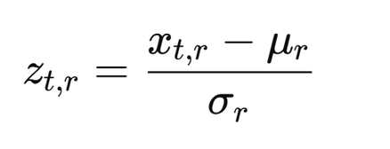
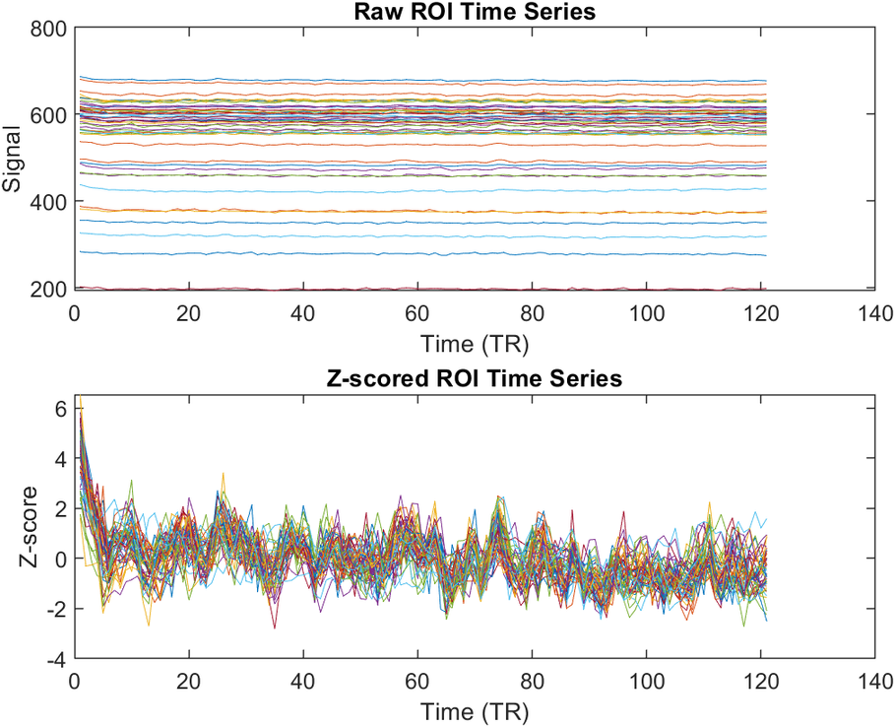
07 - Time-Series Extraction and ROI FC
Visualization and Standardization
A- Z-Scoring per ROI:
Removes baseline amplitude differences.
Ensures comparability across ROIs and subjects.
B- QC Outputs:
Raw timeseries:
Each line represents the mean BOLD signal (in raw scanner intensity units) within one Harvard–Oxford ROI across the 121 timepoints (TRs).
Z-scored timeseries:
After z-scoring, amplitude scaling differences are removed, leaving only relative temporal fluctuations. This makes the signals suitable for FC computation because correlation is sensitive to shared temporal structure.

Slide 25
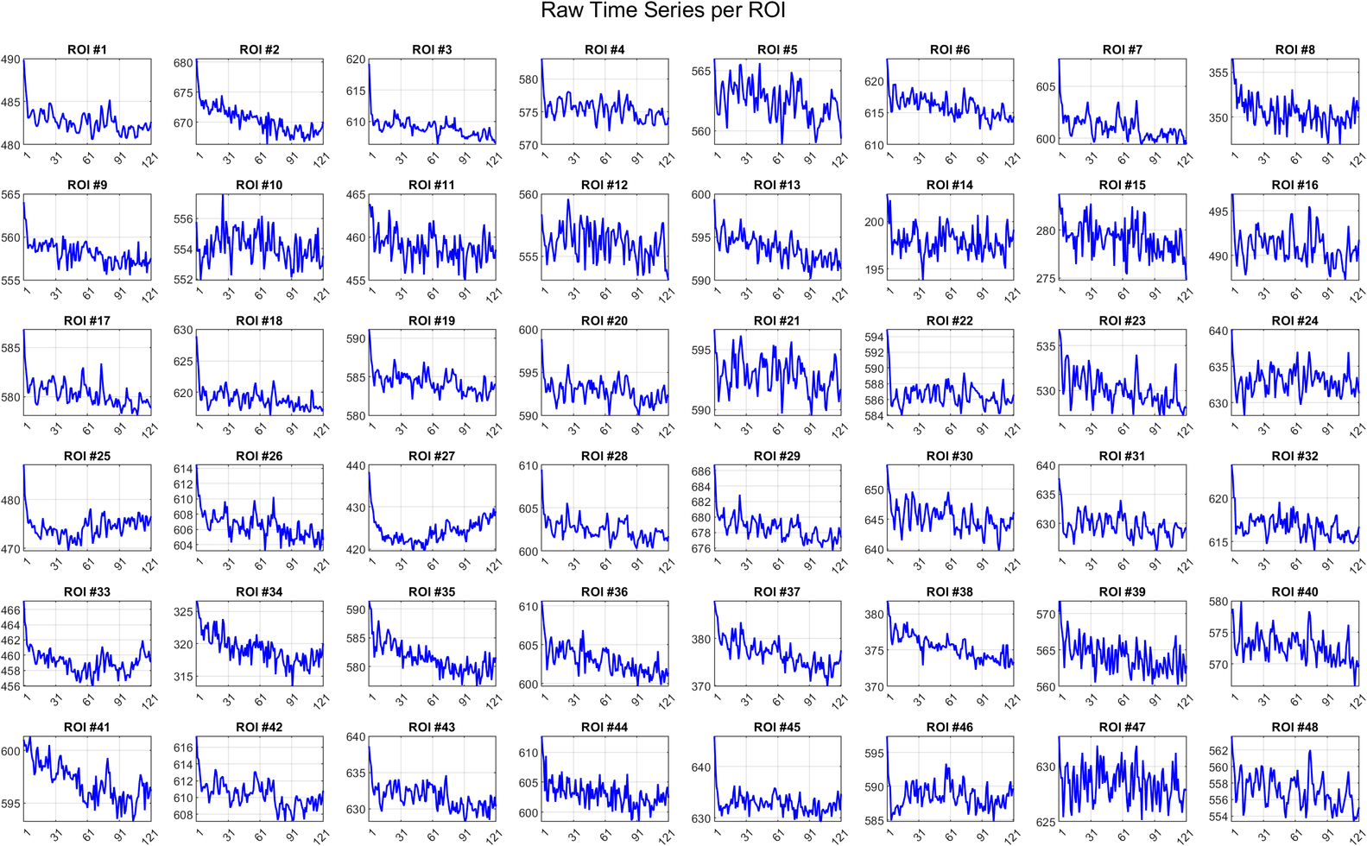
07 - Time-Series Extraction and ROI FC
Visualization of Raw Timeseries per ROI

Slide 26
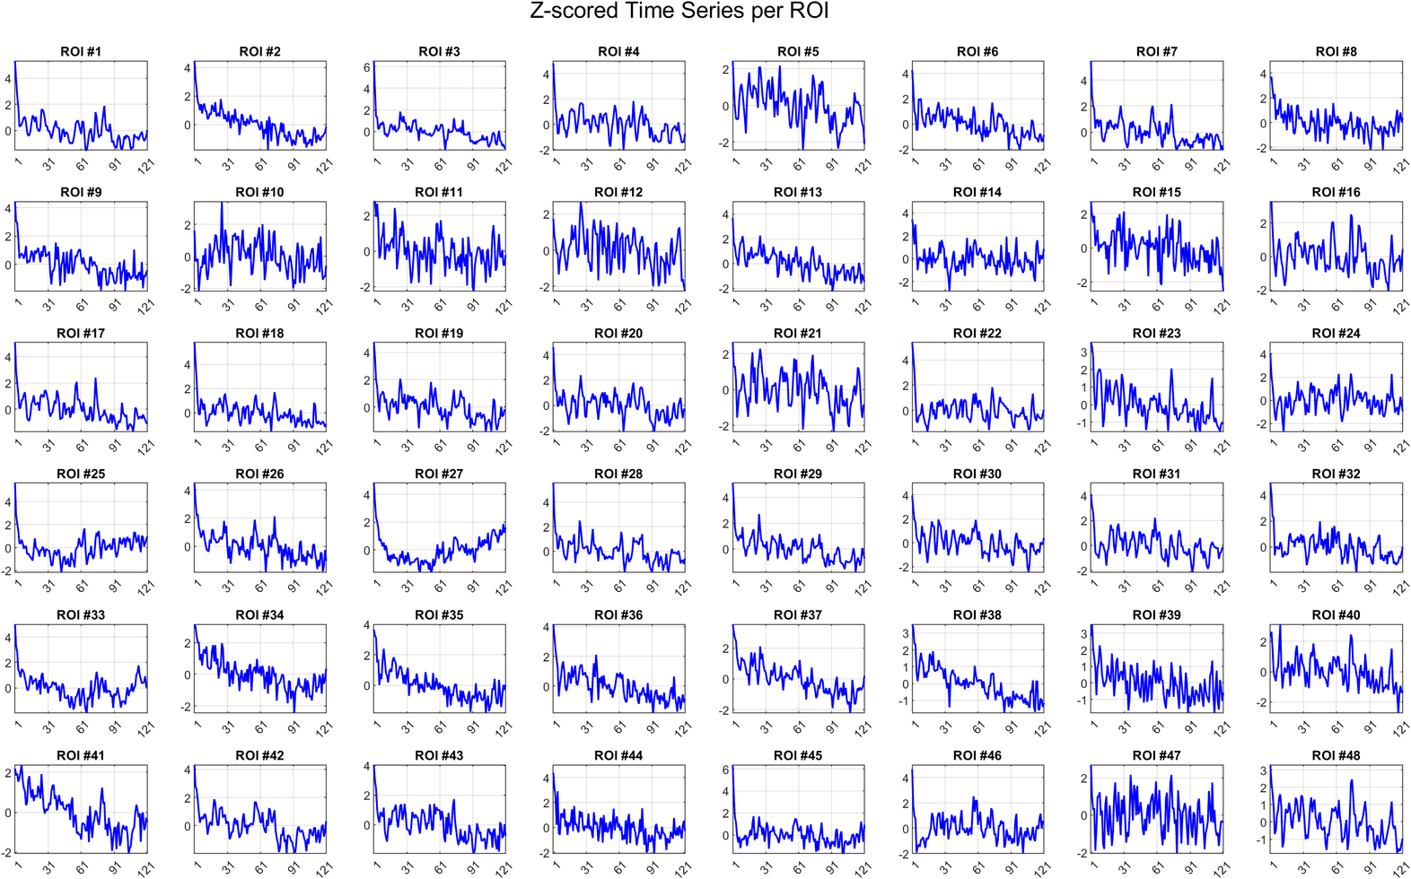
07 - Time-Series Extraction and ROI FC
Visualization of Z-scored Timeseries per ROI

Slide 27
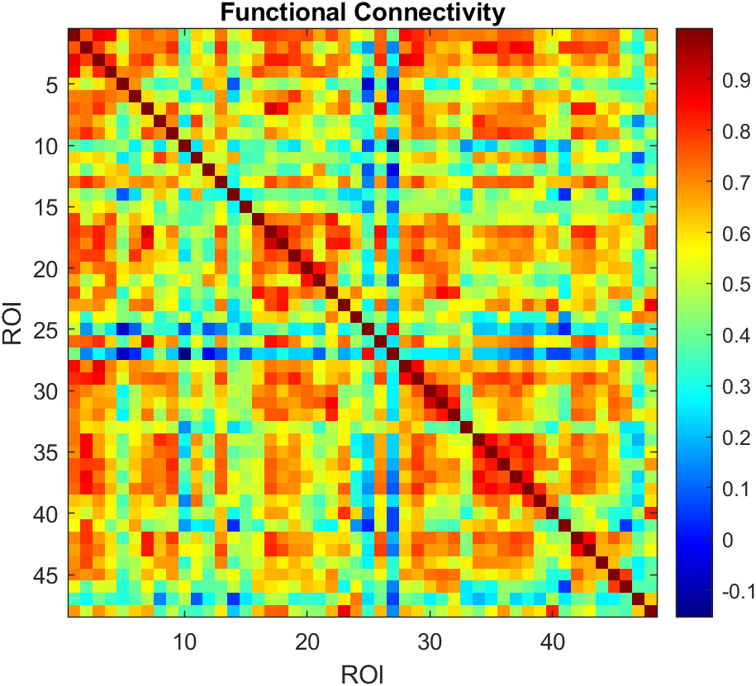
07 - Time-Series Extraction and ROI FC
Visualization of FC Matrix
Each cell shows the temporal correlation between the z-scored mean BOLD signals of two regions (Harvard–Oxford atlas).
The symmetric structure and clustered red blocks indicate coherent functional subnetworks, reflecting intrinsic coordination between cortical and subcortical regions during rest.

Slide 28
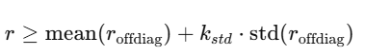
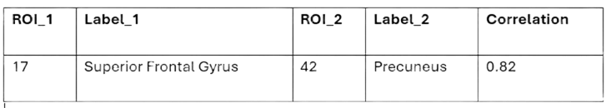
07 - Time-Series Extraction and ROI FC
Identifying Strong ROI-ROI Connection
A- What it does:
Reads the FC matrix and HO XML (ROI names).
Finds ROI pairs whose correlation exceeds a statistical threshold
Builds a table of high-FC pairs with labels and correlation values.
Optionally saves results as a CSV report.
B- Output Table Example:
C- Purpose:
Highlight pairs of brain regions that show strong functional coupling, suggesting network-level communication or co-activation.

Slide 29
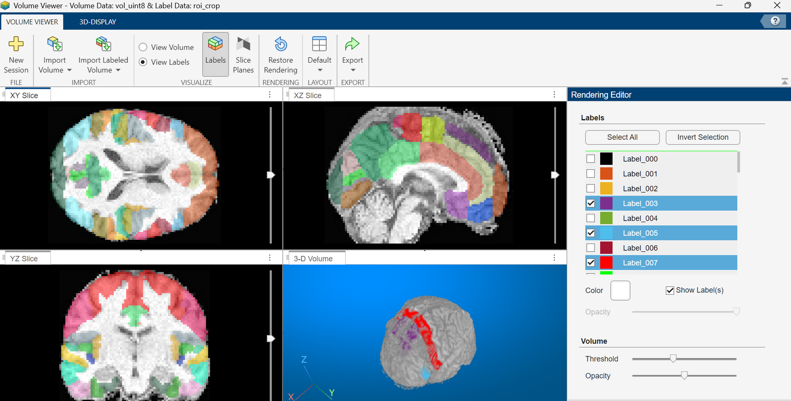
08 - Visualization of the overlaid Atlas on the brain
HO-T1-Underlay

Slide 30
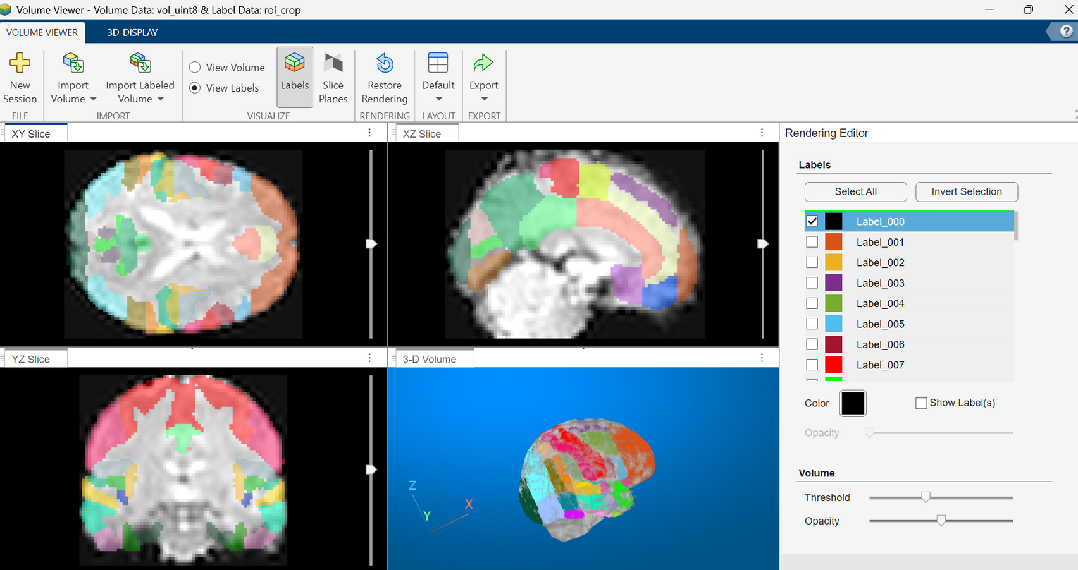
08 - Visualization of the overlaid Atlas on the brain
HO-EPI-Underlay

Slide 31

References
1.Dataset
OpenNeuro. (n.d.). Dataset ds000224: Multi-modal fMRI data. OpenNeuro. Retrieved from OpenNeuro Dataset Description: https://openneuro.org/datasets/ds000224
2.Slice Timing Correction (STC)
Sladky, R., Friston, K. J., Tröstl, J., Cunnington, R., Moser, E., & Windischberger, C. (2011). Slice-timing effects and their correction in functional MRI. NeuroImage, 58(2), 588–594. https://doi.org/10.1016/j.neuroimage.2011.06.078
SPM12 Documentation. (n.d.). Slice timing. Wellcome Centre for Human Neuroimaging.
https://www.fil.ion.ucl.ac.uk/spm/docs/wikibooks/Slice_Timing/
SPM12 Tutorial. (n.d.). fMRI preprocessing: Slice timing. Wellcome Centre for Human Neuroimaging. https://www.fil.ion.ucl.ac.uk/spm/docs/tutorials/fmri/preprocessing/slice_timing/
3.Realignment
Roche A. (2011). A four-dimensional registration algorithm with application to joint correction of motion and slice timing in fMRI. IEEE transactions on medical imaging, 30(8), 1546–1554. https://doi.org/10.1109/TMI.2011.2131152

Slide 32
References
Andy's Brain Book. (n.d.). SPM: Realign & Unwarp. Retrieved from https://andysbrainbook.readthedocs.io/en/latest/SPM/SPM_Short_Course/SPM_04_Preprocessing/01_SPM_Realign_Unwarp.html
SPM12 Manual. (2014). Statistical Parametric Mapping: The Analysis of Functional Brain Images. Wellcome Centre for Human Neuroimaging. https://www.fil.ion.ucl.ac.uk/spm/doc/spm12_manual.pdf
Mikl, M., Marecek, R., Hlustík, P., Pavlicová, M., Drastich, A., Chlebus, P., Brázdil, M., & Krupa, P. (2008). Effects of spatial smoothing on fMRI group inferences. Magnetic resonance imaging, 26(4), 490–503. https://doi.org/10.1016/j.mri.2007.08.006
4.Skull Stripping
SPM12 Tutorial. (n.d.). Segmentation and normalization. Wellcome Centre for Human Neuroimaging.
https://www.fil.ion.ucl.ac.uk/spm/docs/tutorials/fmri_preprocessing/segmentation/

Slide 33
References
5.Coregistration of T1 to EPI
Pluim, J. P. W., Maintz, J. B. A., & Viergever, M. A. (2003). Mutual‐information‐based registration of medical images: A survey. IEEE Transactions on Medical Imaging, 22(8), 986-1004. https://doi.org/10.1109/TMI.2003.815867
Ashburner, J., & Friston, K. J. (1997). Multimodal image coregistration and partitioning—a unified framework. NeuroImage, 6(3), 209–217. https://sci-hub.st/https://doi.org/10.1006/nimg.1997.0290
6.Timeseries and FC
Biswal, B., Yetkin, F. Z., Haughton, V. M., & Hyde, J. S. (1995). Functional connectivity in the motor cortex of resting human brain using echo-planar MRI. Magnetic Resonance in Medicine, 34(4), 537-541. https://sci-hub.st/https://doi.org/10.1002/mrm.1910340409
Brkić, D., Sommariva, S., Schuler, A.-L., Pascarella, A., Belardinelli, P., Isabella, S. L., Di Pino, G., Zago, S., Ferrazzi, G., Rasero, J., Arcara, G., Marinazzo, D., & Pellegrino, G. (2023). The impact of ROI extraction method for MEG connectivity estimation: Practical recommendations for the study of resting state data. NeuroImage, 284, Article 120424. https://www.sciencedirect.com/science/article/pii/S105381192300575X?via%3Dihub

Slide 34
References
7. General References (Applicable to the Entire Pipeline)
(2022). The role of the arousal system in age-related differences in cortical functional network architecture. [Manuscript on ResearchGate]. Retrieved from https://www.researchgate.net/publication/355762769_The_role_of_the_arousal_system_in_age-related_differences_in_cortical_functional_network_architecture
Orlichenko, A., Su, K.-J., Shen, H., Deng, H.-W., & Wang, Y.-P. (2024). Somatomotor-Visual resting state functional connectivity increases after two years in the UK Biobank longitudinal cohort. Journal of Medical Imaging (Bellingham), 11(2), 024010. https://doi.org/10.1117/1.JMI.11.2.024010 SPIE Digital Library+1
(2017).NeuroImage: Clinical, 14, [Article-ID]. https://doi.org/10.1016/j.nicl.2017.05.001
Ashburner, J., & Friston, K. J. (2004). Unified segmentation. NeuroImage, 22(3), 839-851. https://doi.org/10.1016/j.neuroimage.2004.07.051
Sporns, O. (2010). Networks of the brain. Nature Reviews Neuroscience, 10(6), 463-474. https://doi.org/10.1038/nrn756

Slide 35
References
Penny, W., Friston, K., Ashburner, J., Kiebel, S., & Nichols, T. (n.d.). SPM: Statistical Parametric Mapping – Installation guide [Software documentation]. University College London. https://www.fil.ion.ucl.ac.uk/spm/docs/installation/
Radiopaedia. (n.d.). Multiplanar reformation (MPR). In Radiopaedia.org. Retrieved [date you accessed] from https://radiopaedia.org/articles/multiplanar-reformation-mpr?lang=us
Zhang, X., Ying, X., & Toga, A. W. (2022). Human Brain Mapping. Advance online publication. https://doi.org/10.1002/hbm.25841
Ashburner, J., & Friston, K. J. (2010). Voxel-based morphometry — The methods. NeuroImage, 53(2), 936-940. https://doi.org/10.1016/j.neuroimage.2010.08.063
Gordon, E. M., Laumann, T. O., Adeyemo, B., Huckins, J. F., Kelley, W. M., & Petersen, S. E. (2017). Precision functional mapping of individual human brains. Neuron, 95(4), 791-807.e7. https://doi.org/10.1016/j.neuron.2017.07.011

Slide 36
References
Finn, E. S., Shen, X., Scheinost, D., Rosenberg, M. D., Huang, J., Chun, M. M., Papademetris, X., & Constable, R. T. (2015). Functional connectome fingerprinting: identifying individuals using patterns of brain connectivity. Nature neuroscience, 18(11), 1664–1671. https://doi.org/10.1038/nn.4135
Local-global parcellation of the human cerebral cortex from intrinsic functional connectivity MRI | Cerebral Cortex | Oxford academic. (n.d.-a). https://academic.oup.com/cercor/article/28/9/3095/3978804

Slide 37
THANKS!
Do you have any questions?
7200337@studenti.unige.it

